Slide 1
AQA Spanish GCSE
Lifestyle
Vocabulary
Objectives:
To develop reading skills
To develop knowledge of vocabulary
To enhance memory skills

Slide 2
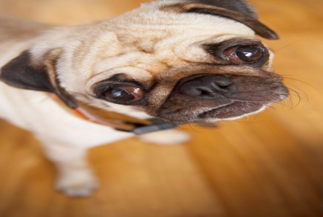
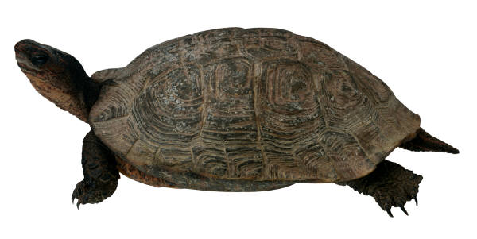
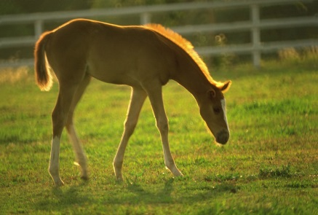
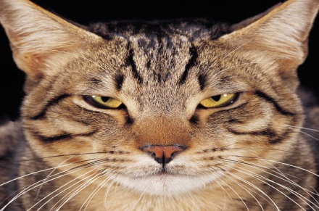
What pets does Felipe want?
Put a tick next to the correct ones.
En mi casa tenemos dos gatos y una tortuga. Yo preferiría tener un caballo o un perro porque son más grandes.

Slide 3


Who has each of the pets below?
En mi casa tengo un caballo pero prefiero los gatos. - Marco
Dog
Fish
Horse
Rabbit
Luc
Tenemos un conejo y una tortuga.
- Carmen
Luisa
Cuando era pequeña tenía un perro pero ahora tengo un pez. - Luisa
Marco
Tengo un perro que se llama Spot - Luc
Carmen

Slide 4
Try to memorise as much of this text as possible.
Now try to write it out using the letters below to help you.
On a new piece of paper, try to write it out again with even less letters to help you.
H_ _ _ _ m_ ll_ _ _ F_ _ _ _ _ y t_ _ _ _ d_ _ g_ _ _ _ q_ _ s_
ll_ _ _ _ J_ _ _ y L_ _ _.
P_ _ _ _ _ _ _ _ _ t_ _ _ _ u_
p_ _ _ _ p_ _ _ _ _ s_ _ m_ _
m_ _ _ _.
H_ _ _ _ _ _ ll_ _ _ _ _ _ _ _ _ y t_ _ _ _ _ _ _ g_ _ _ _ q_ _ s_
ll_ _ _ _ _ _ _ _ y _ _ _ _.
P_ _ _ _ _ _ _ _ _ t_ _ _ _ u_
_ _ _ _ _ p_ _ _ _ _ _ _ _ m_ _
m_ _ _ _.
Hola me llamo Felipe y tengo dos gatos que se llaman Juan y Lola. Preferiría tener un perro porque son más monos.

Slide 5
What is this an invitation to?
INVITACIÓN de BODA
El cuatro de mayo en El Parque Retiro, Madrid
ANSWER: Wedding

Slide 6
Match up the vocabulary below
ajo | grilled
a la plancha | drunk
arroz | cabbage
borracho | sweet
cena | garlic
col | biscuits
dulce | evening meal
galleta | rice
garlic
grilled
rice
drunk
evening meal
cabbage
sweet
biscuit

Slide 7

What is the article about?
ANSWER: Benefits of drinking green tea

Slide 8
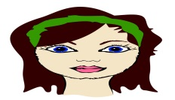
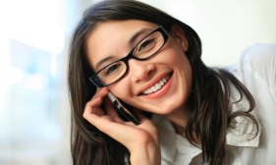
Match up the vocabulary with the images
pelirrojo
rubio
castaño
gafas
bigote
barba

Slide 9
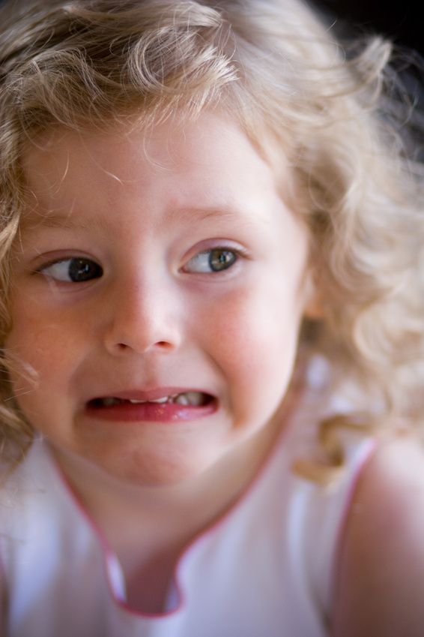
What is this person complaining about?
Tengo hambre
ANSWER: They’re hungry

Slide 10
Match up the vocabulary below
cuerpo | heart
corazón | health
cansado | brain
enfermedad | tired
pulmones | vein
cerebro | body
vena | lungs
salud | illness
body
heart
tired
illness
lungs
brain
vein
health

Slide 11

What does this image say?

Slide 12

What does this image say to avoid?
1 ___________________________
2___________________________
3___________________________
ANSWER: salt, sugar, fat

Slide 13
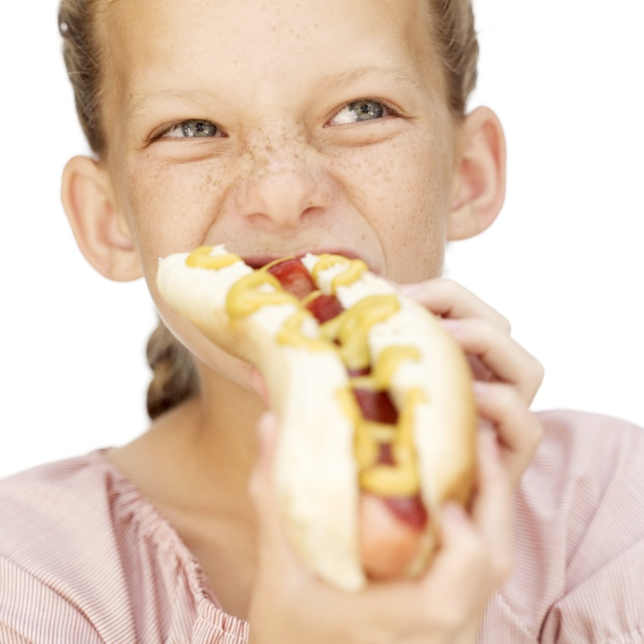
What is this person complaining about?
Tengo sed
ANSWER: They’re thirsty

Slide 14
Match up the vocabulary below
bebida | beer
cerveza | snack
mariscos | nut
merienda | cheese
nuez | seafood
pescado | lettuce
queso | drink
lechuga | fish
drink
beer
seafood
snack
nut
fish
cheese
lettuce

Slide 15
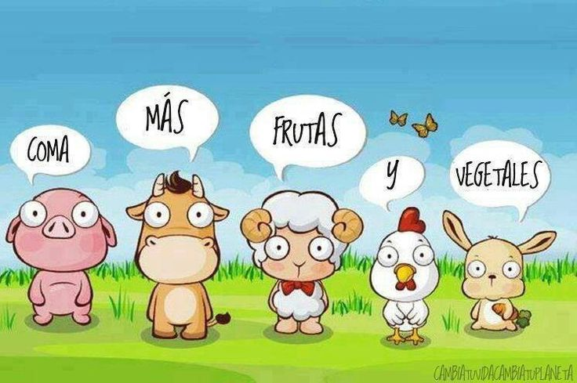
What does this image recommend?
ANSWER: eat more fruit and vegetables

Slide 16
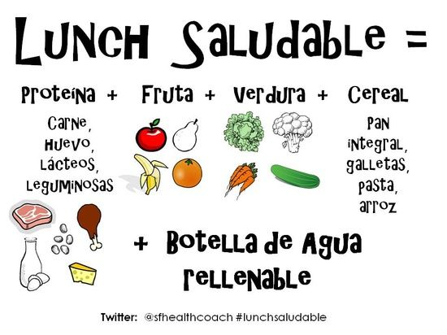
What do you need for a healthy lunch?
1 ___________________________
2___________________________
3___________________________
4___________________________
5___________________________
ANSWER: protein, fruit, vegetables, cereal, a bottle of water

Slide 17
Decide if these verbs are in the past, present or the future
Desayuno | Present
Voy a comer | Future
Desayunaba | Past
Bebí | Past
Comí | Past
Como | Present
Ceno | Present
Voy a cenar | Future

Slide 18
Match up the vocabulary below
alegre | funny
simpático | talkative
gracioso | lazy
amable | friendly
hablador | kind
travieso | stupid
tonto | naughty
perezoso | happy
alegre | happy
simpático | friendly
gracioso | funny
amable | kind
hablador | talkative
travieso | naughty
tonto | stupid
perezoso | lazy

Slide 19
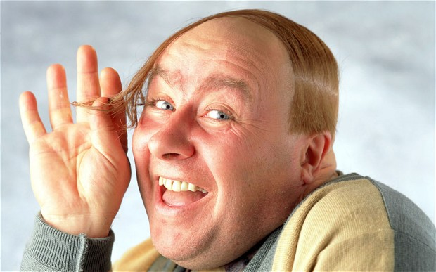
What is this man asking for?
La cuenta, por favor
ANSWER: the bill please

Slide 20
Find out what these people do to keep fit
Voy al gimnasio cuando tengo tiempo o hago deporte. - Marco
jogging, tennis
tennis, horseriding
gym, do sport
only in P.E
Luc
Solo hago ejercicio en las clases de educación física. - Carmen
Luisa
Juego al tenis todos los días y hago equitación. - Luisa
Marco
Hago el footing y juego al tenis cuando puedo. - Luc
Carmen

Slide 21
What desserts are available?
Menú
Primer plato
Ensalada mixta 2,5€
Sopa de verduras 3€
Sopa de pollo 3,5€
Segundo plato
Pollo con patatas fritas o ensalada 10€
Mariscos 15€
Postre
Fruta 1€
Helado 3€
Bebidas
Agua mineral 1€
Agua con gas 1,5€
Zumo de naranja 2€
Vino tinto 4€

Slide 22
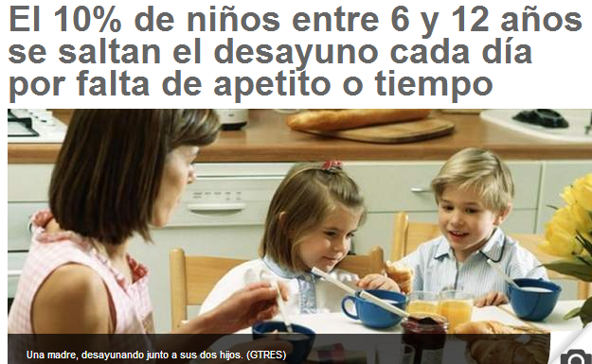
What is this article about?
ANSWER: children skipping breakfast

Slide 23
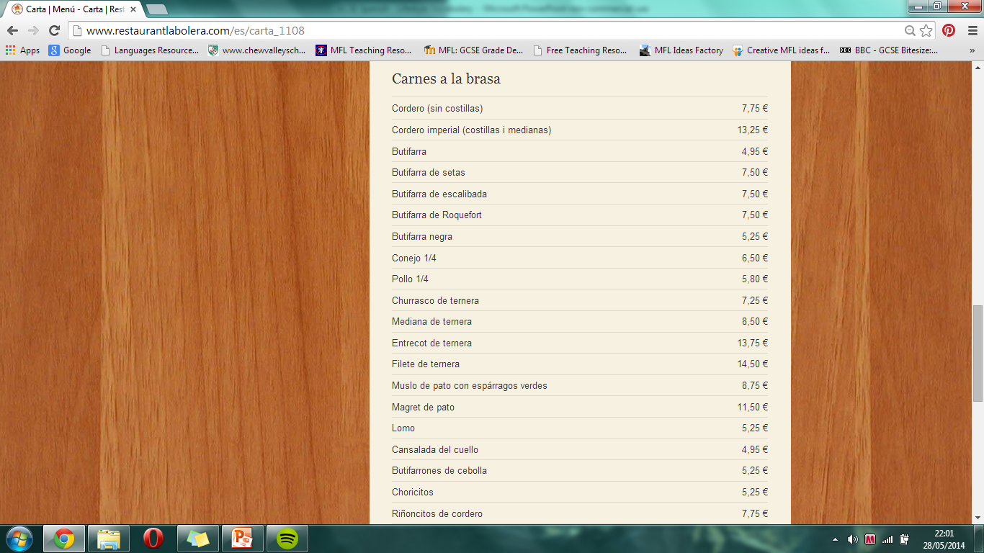
Read the Spanish menu and complete the grid.
Food | Price
Chicken
 | 6,50
Lamb

Slide 24
Match up the vocabulary below
atrevido | proud
celoso | rude
maleducado | polite
orgulloso | greedy
mentiroso | daring
glotón | selfish
cortés | liar
egoísta | jealous
atrevido | daring
celoso | jealous
maleducado | rude
orgulloso | proud
mentiroso | liar
glotón | greedy
cortés | polite
egoísta | selfish

Slide 25
What drinks are available?
Menú
Primer plato
Ensalada mixta 2,5€
Sopa de verduras 3€
Sopa de pollo 3,5€
Segundo plato
Pollo con patatas fritas o ensalada 10€
Mariscos 15€
Postre
Fruta 1€
Helado 3€
Bebidas
Agua mineral 1€
Agua con gas 1,5€
Zumo de naranja 2€
Vino tinto 4€

Slide 26
Try to think of ways to remember the translations of these words.
grasa | fat
enfermo | ill
amable | kind
bigote | moustache
sida | Aids
gafas | glasses
joven | young

Slide 27

Eating healthy doesn’t have to be ___________
ANSWER: expensive

Slide 28
What starters are available?
Menú
Primer plato
Ensalada mixta 2,5€
Sopa de verduras 3€
Sopa de pollo 3,5€
Segundo plato
Pollo con patatas fritas o ensalada 10€
Mariscos 15€
Postre
Fruta 1€
Helado 3€
Bebidas
Agua mineral 1€
Agua con gas 1,5€
Zumo de naranja 2€
Vino tinto 4€

Slide 29
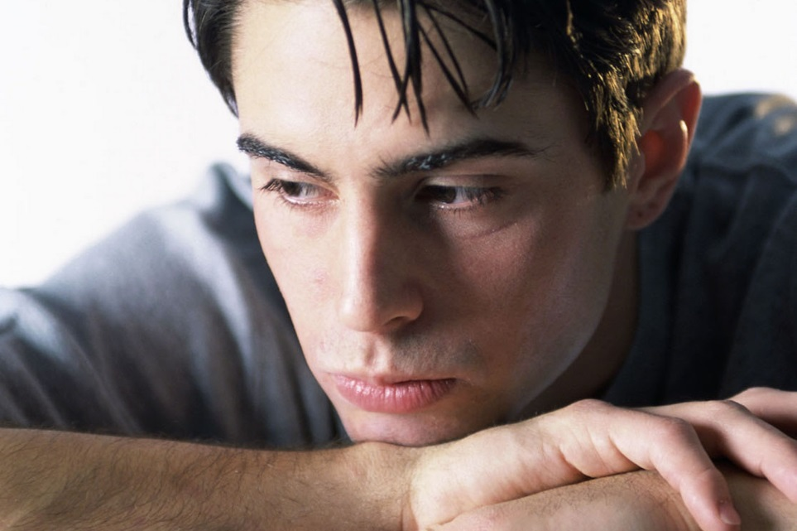
What is this person complaining about?
Tengo dolor de la cabeza y las orejas
ANSWER: He has headache and earache

Slide 30

Healthy _______.
Less __________.
ANSWER: Healthy worklife. Less stress.

Slide 31
Read the Spanish menu and complete the grid.
Menú
Primer plato
Ensalada mixta 2,5€
Sopa de verduras 3€
Sopa de pollo 3,5€
Segundo plato
Pollo con patatas fritas o ensalada 10€
Mariscos 15€
Postre
Fruta 1€
Helado 3€
Bebidas
Agua mineral 1€
Agua con gas 1,5€
Zumo de naranja 2€
Vino tinto 4€
FOOD | PRICE
Chicken soup
Seafood
Ice cream
Sparkling water
Red wine

Slide 32
Try to think of ways to remember the translations of these words.
extranjeros | foreigners
la pobreza | poverty
el paro | unemployment
juventud | youth
identidad | identity
sin techo | homeless
gente pobre | poor people

Slide 33
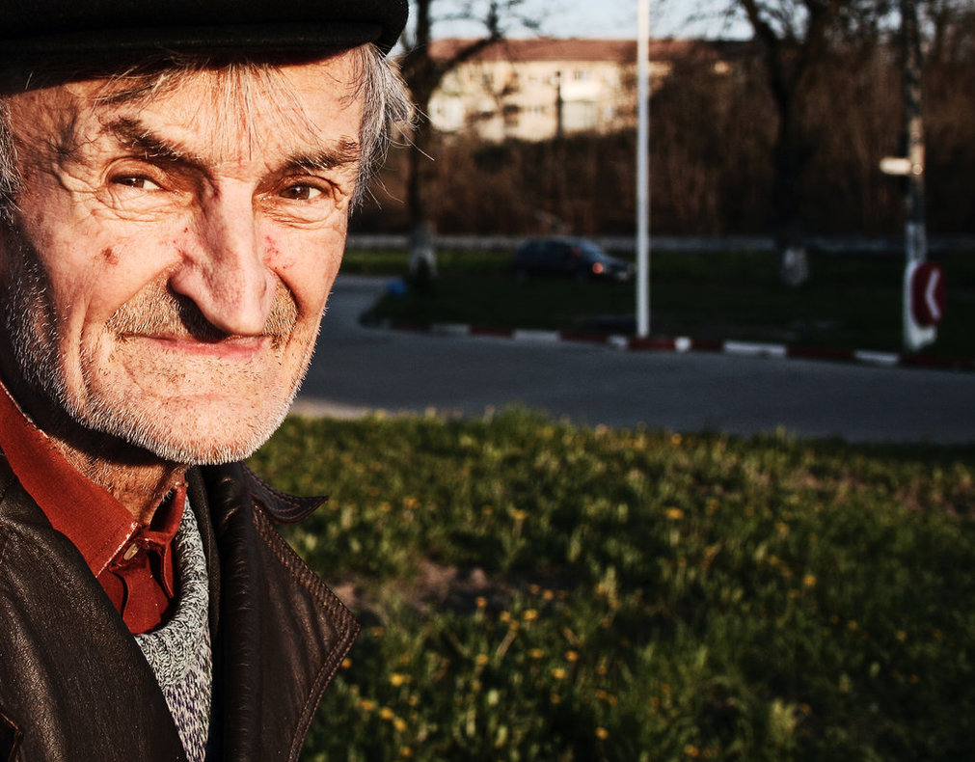
What is this person complaining about?
Tengo dolor de las piernas y la espalda
ANSWER: He has leg and backache

Slide 34
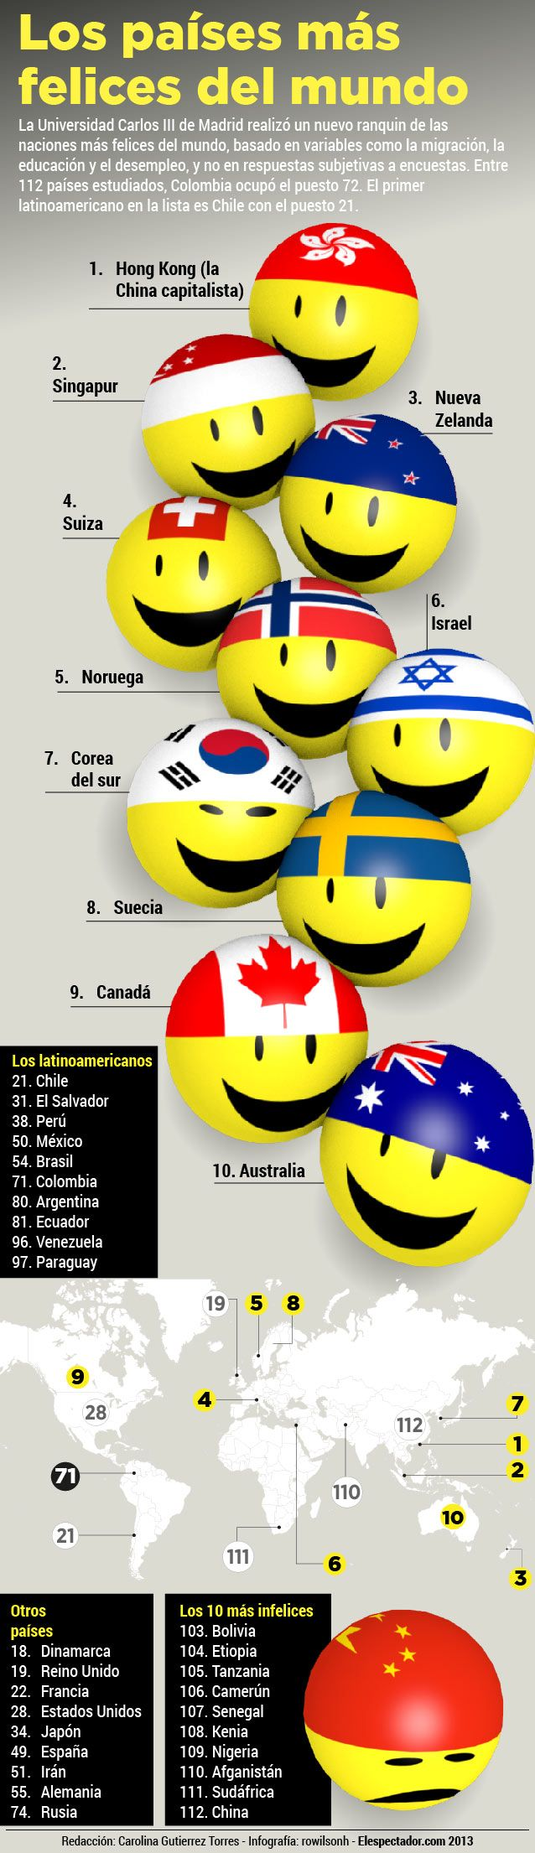
What is the article about?
ANSWER: The happiest countries in the world

Slide 35
Unscramble the letters to find the translations of these words
extranjeros | foreigners
la pobreza | poverty
el paro | unemployment
juventud | youth
identidad | identity
sin techo | homeless
gente pobre | poor people
rsjxoetenar | foreigners
al brozape | poverty
le rpao | unemployment
dvunteju | youth
dntidiaed | identity
nis chote | homeless
tenge orpeb | poor people

Slide 36
Decide if these phrases are positive or negative.
malo para la salud
delicioso
comida sana
rico
contiene mucha grasa
nutritivo
contiene poca grasa
contiene mucho azúcar
buenísimo
dieta sana
N
P
P
P
N
P
P
N
P
P

Slide 37
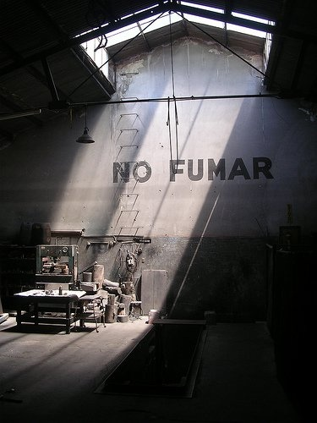
What does the sign say?
ANSWER: No smoking

Slide 38
Try to think of ways to remember the translations of these words.
sin techo | homeless
gamberro | hooligan
la prensa | the press
los derechos humanos | human rights
obra benéfica | charity
quejarse de | complain about
aumentar | to increase

Slide 39
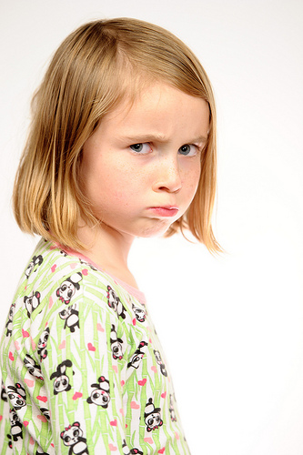
What is this person complaining about?
Tengo dolor del estómago
ANSWER: She has stomach ache

Slide 40
What mains are available?
Menú
Primer plato
Ensalada mixta 2,5€
Sopa de verduras 3€
Sopa de pollo 3,5€
Segundo plato
Pollo con patatas fritas o ensalada 10€
Mariscos 15€
Postre
Fruta 1€
Helado 3€
Bebidas
Agua mineral 1€
Agua con gas 1,5€
Zumo de naranja 2€
Vino tinto 4€

Slide 41
Unscramble the letters to find the translations of these words
sin techo | homeless
gamberro | hooligan
la prensa | the press
los derechos humanos | human rights
obra benéfica | charity
quejarse de | complain about
aumentar | to increase
nis tehoc | homeless
rrogmbae | hooligan
al renspa | the press
ols redehocs umhanso | human rights
roba béfecina | charity
qujersae ed | complain about
eraamunt | to increase

Slide 42
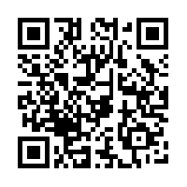
Scan this to find games to help you learn ‘Lifestyle’ vocabulary

