Slide 1
¿Te gusta tu casa? Do you like your house?
viernes, 21 de abril de 2017
By the end of the lesson:
Bronze: I can give justified opinions about where I live.
e.g. I like my house because it is big.
Silver: I can further develop my opinion
using ‘sin embargo’ and ‘aunque’.
e.g. I like my house because it is big however it is old.
Gold: I can give other people's opinions.
e.g. I like my house because it is big, however it is old. My mum likes it because it is pretty.
PARA EMPEZAR / STARTER:
Empareja el vocabulario en tu papel / Match up the opinions vocabulary on your sheet
Extension: What adjectives (describing words) could you use to describe a house? e.g. pequeño (small)

Slide 2
¿Te gusta tu casa? Do you like your house?
By the end of the lesson:
Bronze: I can give justified opinions about where I live.
e.g. I like my house because it is big.
Silver: I can further develop my opinion
using ‘sin embargo’ and ‘aunque’.
e.g. I like my house because it is big however it is old.
Gold: I can give other people's opinions.
e.g. I like my house because it is big, however it is old. My mum likes it because it is pretty.
viernes, 21 de abril de 2017
Empareja el vocabulario / Match up the vocabulary
Me encanta I hate
Me gusta My mum likes
No me gusta I love
Odio I like
Detesto My dad loves
Pienso que I don’t like
A mi madre le gusta I hate
A mi padre le encanta I think that

Slide 3
By the end of the lesson…
viernes, 21 de abril de 2017
Bronze: I can give justified opinions about where I live.
e.g. I like my house because it is big.
Silver: I can further develop my opinion using ‘sin embargo’ and ‘aunque’.
e.g. I like my house because it is big however it is old.
Gold: I can give other people's opinions.
e.g. I like my house because it is big, however it is old. My mum likes it because it is pretty.

Slide 4
Los Adjetivos Adjectives
By the end of the lesson:
Bronze: I can give justified opinions about where I live.
e.g. I like my house because it is big.
Silver: I can further develop my opinion
using ‘sin embargo’ and ‘aunque’.
e.g. I like my house because it is big however it is old.
Gold: I can give other people's opinions.
e.g. I like my house because it is big, however it is old. My mum likes it because it is pretty.
viernes, 21 de abril de 2017
Me gusta mi piso porque es…
Me encanta mi casa porque es…
No me gusta mi granja porque es…

Slide 5
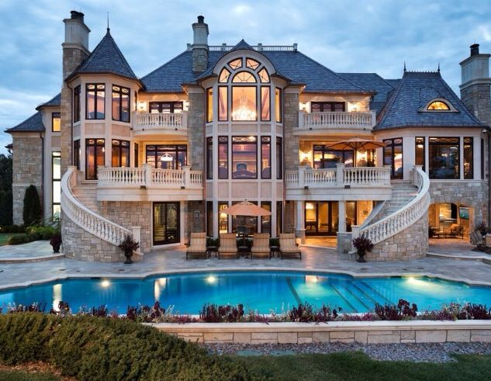
By the end of the lesson:
Bronze: I can give justified opinions about where I live.
e.g. I like my house because it is big.
Silver: I can further develop my opinion
using ‘sin embargo’ and ‘aunque’.
e.g. I like my house because it is big however it is old.
Gold: I can give other people's opinions.
e.g. I like my house because it is big, however it is old. My mum likes it because it is pretty.
viernes, 21 de abril de 2017
grande
big

Slide 6
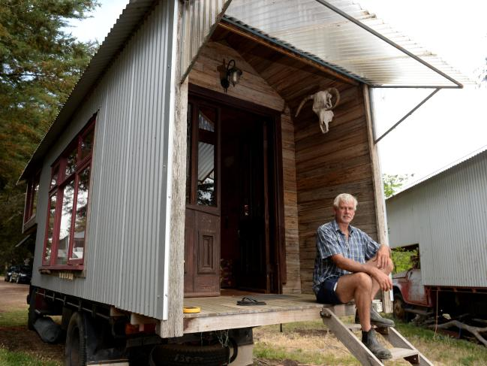
By the end of the lesson:
Bronze: I can give justified opinions about where I live.
e.g. I like my house because it is big.
Silver: I can further develop my opinion
using ‘sin embargo’ and ‘aunque’.
e.g. I like my house because it is big however it is old.
Gold: I can give other people's opinions.
e.g. I like my house because it is big, however it is old. My mum likes it because it is pretty.
viernes, 21 de abril de 2017
un piso pequeño una casa pequeña
pequeño
pequeña
small

Slide 7
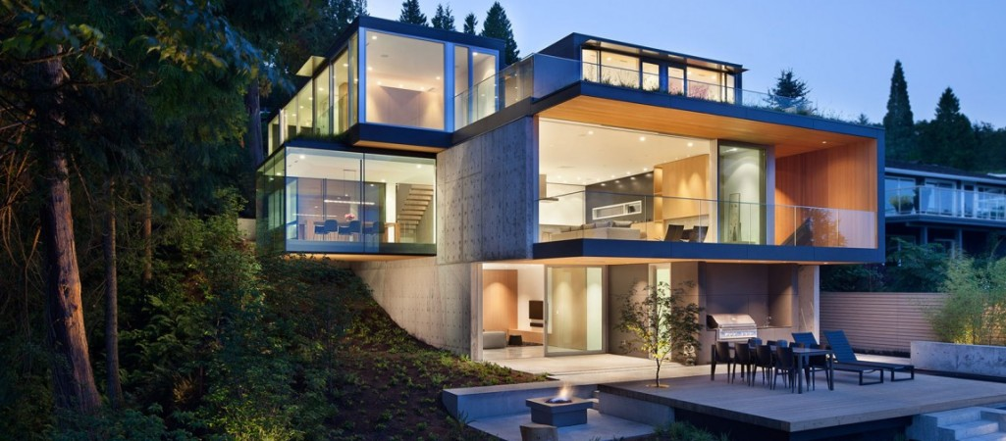
By the end of the lesson:
Bronze: I can give justified opinions about where I live.
e.g. I like my house because it is big.
Silver: I can further develop my opinion
using ‘sin embargo’ and ‘aunque’.
e.g. I like my house because it is big however it is old.
Gold: I can give other people's opinions.
e.g. I like my house because it is big, however it is old. My mum likes it because it is pretty.
viernes, 21 de abril de 2017
moderno
moderna
modern

Slide 8
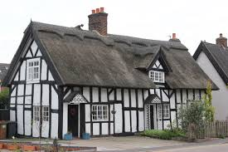
By the end of the lesson:
Bronze: I can give justified opinions about where I live.
e.g. I like my house because it is big.
Silver: I can further develop my opinion
using ‘sin embargo’ and ‘aunque’.
e.g. I like my house because it is big however it is old.
Gold: I can give other people's opinions.
e.g. I like my house because it is big, however it is old. My mum likes it because it is pretty.
viernes, 21 de abril de 2017
antiguo
antigua
old

Slide 9
By the end of the lesson:
Bronze: I can give justified opinions about where I live.
e.g. I like my house because it is big.
Silver: I can further develop my opinion
using ‘sin embargo’ and ‘aunque’.
e.g. I like my house because it is big however it is old.
Gold: I can give other people's opinions.
e.g. I like my house because it is big, however it is old. My mum likes it because it is pretty.
viernes, 21 de abril de 2017
nuevo
nueva
new

Slide 10
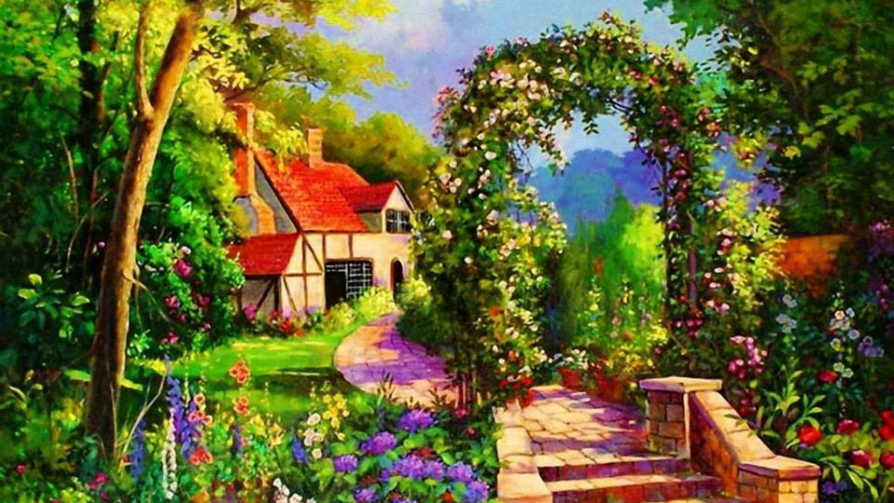
By the end of the lesson:
Bronze: I can give justified opinions about where I live.
e.g. I like my house because it is big.
Silver: I can further develop my opinion
using ‘sin embargo’ and ‘aunque’.
e.g. I like my house because it is big however it is old.
Gold: I can give other people's opinions.
e.g. I like my house because it is big, however it is old. My mum likes it because it is pretty.
viernes, 21 de abril de 2017
bonito
bonita
pretty

Slide 11
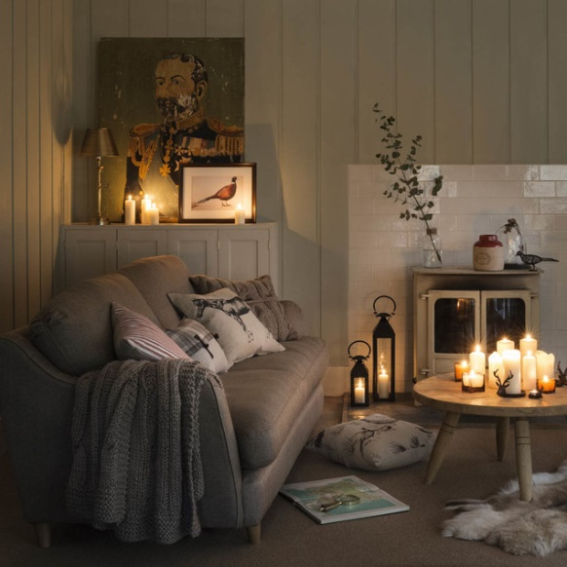
By the end of the lesson:
Bronze: I can give justified opinions about where I live.
e.g. I like my house because it is big.
Silver: I can further develop my opinion
using ‘sin embargo’ and ‘aunque’.
e.g. I like my house because it is big however it is old.
Gold: I can give other people's opinions.
e.g. I like my house because it is big, however it is old. My mum likes it because it is pretty.
viernes, 21 de abril de 2017
acogedor
acogedora
cosy

Slide 12
By the end of the lesson:
Bronze: I can give justified opinions about where I live.
e.g. I like my house because it is big.
Silver: I can further develop my opinion
using ‘sin embargo’ and ‘aunque’.
e.g. I like my house because it is big however it is old.
Gold: I can give other people's opinions.
e.g. I like my house because it is big, however it is old. My mum likes it because it is pretty.
viernes, 21 de abril de 2017
cómodo
cómoda
comfortable

Slide 13
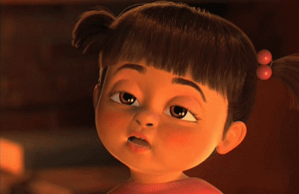
By the end of the lesson:
Bronze: I can give justified opinions about where I live.
e.g. I like my house because it is big.
Silver: I can further develop my opinion
using ‘sin embargo’ and ‘aunque’.
e.g. I like my house because it is big however it is old.
Gold: I can give other people's opinions.
e.g. I like my house because it is big, however it is old. My mum likes it because it is pretty.
viernes, 21 de abril de 2017
aburrido
aburrida
boring

Slide 14
By the end of the lesson:
Bronze: I can give justified opinions about where I live.
e.g. I like my house because it is big.
Silver: I can further develop my opinion
using ‘sin embargo’ and ‘aunque’.
e.g. I like my house because it is big however it is old.
Gold: I can give other people's opinions.
e.g. I like my house because it is big, however it is old. My mum likes it because it is pretty.
viernes, 21 de abril de 2017
Mi casa es bastante…
aburrido
aburrida

Slide 15
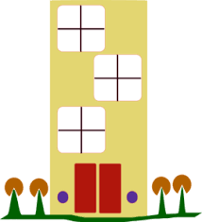
By the end of the lesson:
Bronze: I can give justified opinions about where I live.
e.g. I like my house because it is big.
Silver: I can further develop my opinion
using ‘sin embargo’ and ‘aunque’.
e.g. I like my house because it is big however it is old.
Gold: I can give other people's opinions.
e.g. I like my house because it is big, however it is old. My mum likes it because it is pretty.
viernes, 21 de abril de 2017
Mi piso es muy…
bonito
bonita

Slide 16
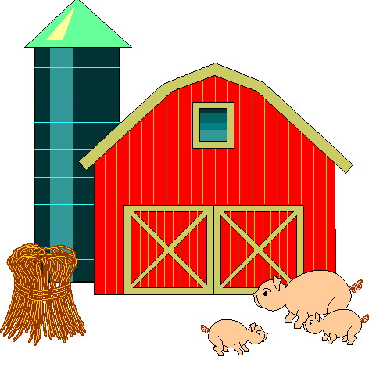
By the end of the lesson:
Bronze: I can give justified opinions about where I live.
e.g. I like my house because it is big.
Silver: I can further develop my opinion
using ‘sin embargo’ and ‘aunque’.
e.g. I like my house because it is big however it is old.
Gold: I can give other people's opinions.
e.g. I like my house because it is big, however it is old. My mum likes it because it is pretty.
viernes, 21 de abril de 2017
Mi granja es muy…
pequeño
pequeña

Slide 17
viernes, 21 de abril de 2017
By the end of the lesson:
Bronze: I can give justified opinions about where I live.
e.g. I like my house because it is big.
Silver: I can further develop my opinion
using ‘sin embargo’ and ‘aunque’.
e.g. I like my house because it is big however it is old.
Gold: I can give other people's opinions.
e.g. I like my house because it is big, however it is old. My mum likes it because it is pretty.
Actividad 1
Crea unas frases con las cartas / Create some phrases with the cards.
Actividad 2
Escribe 3-6 de las frases y traduce en inglés / Copy 3-6 of the phrases and translate into English
Extension: decide what the categories of the cards are
Extension: Can you extend these sentences with any extra details?

Slide 18
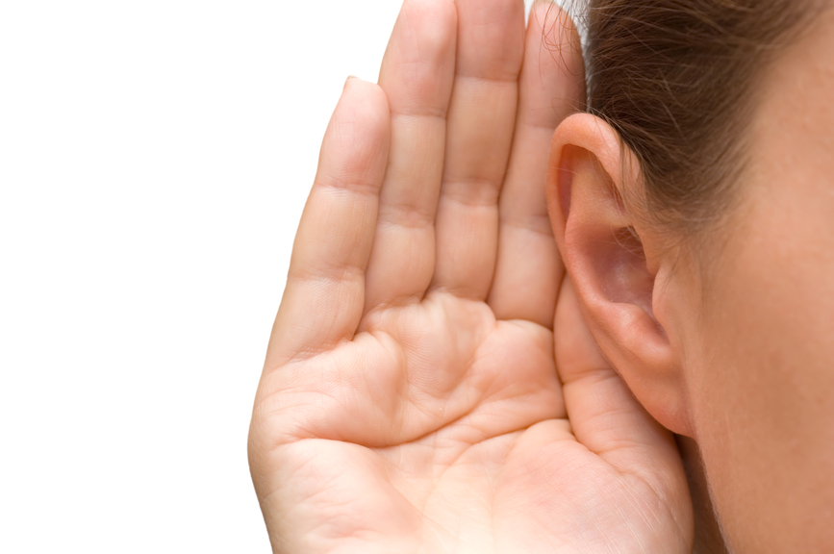
By the end of the lesson:
Bronze: I can give justified opinions about where I live.
e.g. I like my house because it is big.
Silver: I can further develop my opinion
using ‘sin embargo’ and ‘aunque’.
e.g. I like my house because it is big however it is old.
Gold: I can give other people's opinions.
e.g. I like my house because it is big, however it is old. My mum likes it because it is pretty.
viernes, 21 de abril de 2017

Slide 19
By the end of the lesson:
Bronze: I can give justified opinions about where I live.
e.g. I like my house because it is big.
Silver: I can further develop my opinion
using ‘sin embargo’ and ‘aunque’.
e.g. I like my house because it is big however it is old.
Gold: I can give other people's opinions.
e.g. I like my house because it is big, however it is old. My mum likes it because it is pretty.
viernes, 21 de abril de 2017
Escucha las frases y pon las cartas en el orden correcto
/ Listen to the sentences and make sure the cards are in the correct order

Slide 20
¿Te gusta tu casa? Do you like your house?
By the end of the lesson:
Bronze: I can give justified opinions about where I live.
e.g. I like my house because it is big.
Silver: I can further develop my opinion
using ‘sin embargo’ and ‘aunque’.
e.g. I like my house because it is big however it is old.
Gold: I can give other people's opinions.
e.g. I like my house because it is big, however it is old. My mum likes it because it is pretty.
viernes, 21 de abril de 2017
Persona A: ¿Te gusta tu casa?
Persona B: Me encanta mi casa porque es bonita
sin embargo es pequeña.
A mi madre le encanta
porque es moderna. ¿Y tú?

Slide 21
¿Te gusta tu casa? Do you like your house?
By the end of the lesson:
Bronze: I can give justified opinions about where I live.
e.g. I like my house because it is big.
Silver: I can further develop my opinion
using ‘sin embargo’ and ‘aunque’.
e.g. I like my house because it is big however it is old.
Gold: I can give other people's opinions.
e.g. I like my house because it is big, however it is old. My mum likes it because it is pretty.
viernes, 21 de abril de 2017
Traducir / Translate
I like my flat because it is cosy.
I like my flat because it is cosy, however it is very small.
I like my flat because it is cosy, however it is very small. My dad loves it because it is modern.

