Slide 1
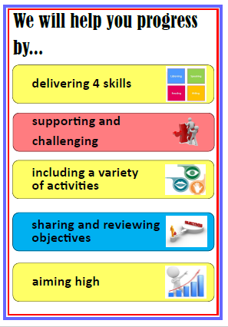
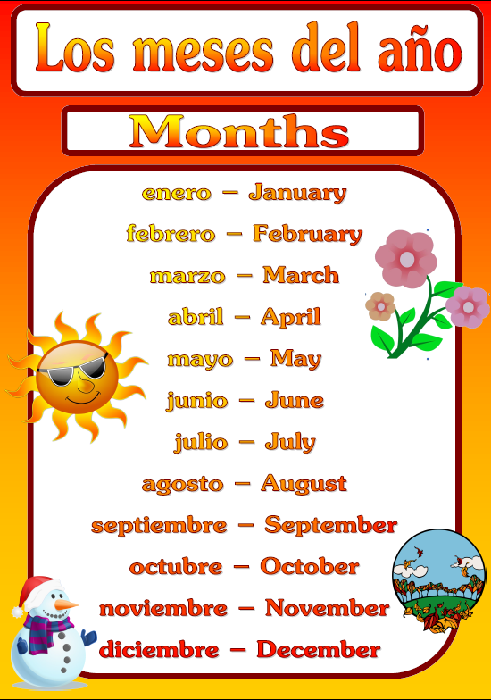
Welcome to Mrs Warren’s Virtual Classroom
YEAR 8 SPANISH
HOME LEARNING
TEAMS Week 7 – 18/5/2020
TEAMS Week 8 – 25/5/2020
TEAMS Week 9 – 01/6/2020

