Slide 1
Las Mascotas
Pets
OBJETIVOS:
Bronce:
TBAT give information about what pets I have, and someone else has
Plata:
TBAT say what pets I used to have when I was little
Oro:
TBAT say what pets I would like to have in the future
LITERACY:
Spellings
lunes el 28 de enero
5 Minute Challenge – El Presente
 | hablar | comer | vivir | **tener
I | hablo
You s.
He/she
We
You pl.
They |  |  |  | tienen
**Irregular

Slide 2
Las Mascotas
Pets
OBJETIVOS:
Bronce:
TBAT give information about what pets I have, and someone else has
Plata:
TBAT say what pets I used to have when I was little
Oro:
TBAT say what pets I would like to have in the future
LITERACY:
Spellings
lunes el 28 de enero
5 Minute Challenge – El Presente
 | hablar | comer | vivir | **tener
I | hablo | como | vivo | tengo
You s. | hablas | comes | vives | tienes
He/she | habla | come | vive | tiene
We | hablamos | comemos | vivimos | tenemos
You pl. | habláis | coméis | vivís | tenéis
They | hablan | comen | viven | tienen

Slide 3
Las Mascotas
Pets
lunes el 28 de enero
OBJETIVOS:
Bronce:
TBAT give information about what pets I have, and someone else has
Plata:
TBAT say what pets I used to have when I was little
Oro:
TBAT say what pets I would like to have in the future
LITERACY:
Spellings

Slide 4
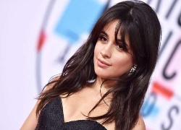
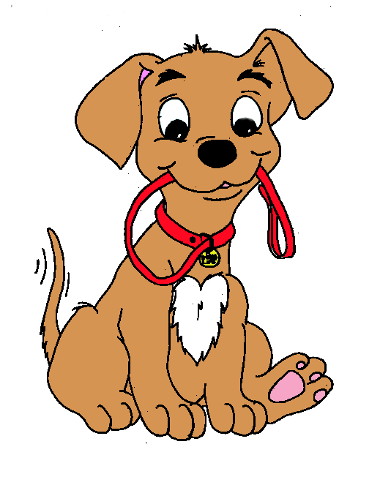
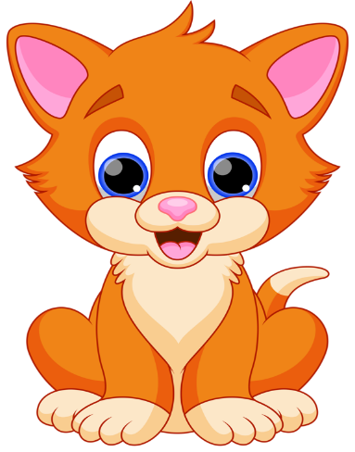
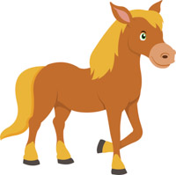
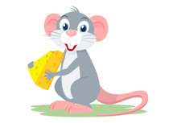
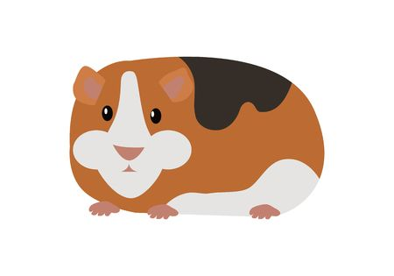
TENGO…
OBJETIVOS:
Bronce:
TBAT give information about what pets I have, and someone else has
Plata:
TBAT say what pets I used to have when I was little
Oro:
TBAT say what pets I would like to have in the future
LITERACY:
Spellings
un perro
un gato
un caballo
un ratón
un hámster
un cobayo

Slide 5
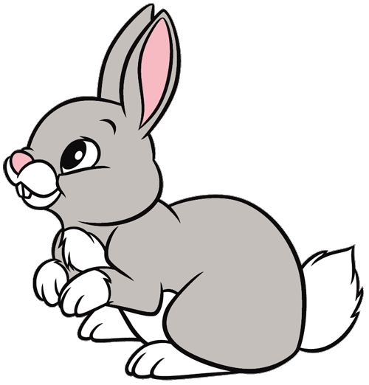
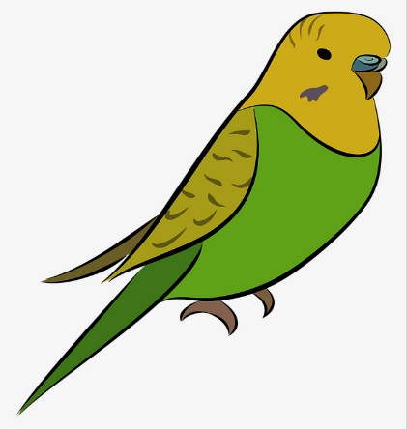
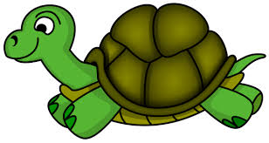
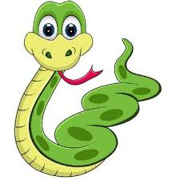
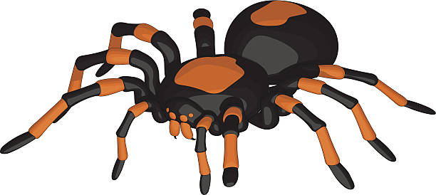
TENGO…
OBJETIVOS:
Bronce:
TBAT give information about what pets I have, and someone else has
Plata:
TBAT say what pets I used to have when I was little
Oro:
TBAT say what pets I would like to have in the future
LITERACY:
Spellings
un conejo
un pájaro
un pez
una tortuga
una araña
una serpiente

Slide 6
OBJETIVOS:
Bronce:
TBAT give information about what pets I have, and someone else has
Plata:
TBAT say what pets I used to have when I was little
Oro:
TBAT say what pets I would like to have in the future
LITERACY:
Spellings
THINK, PAIR, SHARE
Tengo un pez que se llama Bob.
Tengo dos peces que se llaman Ben y Jerry.
TRADUCE:
I have a cat who is called Charlie.
I have a hamster who is called Smartie.
I have two guinea pigs who are called Fudge and Blossom.

Slide 7
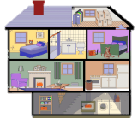
OBJETIVOS:
Bronce:
TBAT give information about what pets I have, and someone else has
Plata:
TBAT say what pets I used to have when I was little
Oro:
TBAT say what pets I would like to have in the future
LITERACY:
Spellings
OBJETIVOS:
Bronce:
TBAT say what rooms there are and aren’t in my house.
Plata:
TBAT give a justified opinion about my house.
Oro:
TBAT say what rooms I’d like to have in my house.
LITERACY:
Spellings
CATEGORISE
Can you put the pets below into the two categories in the grid?
MASCULINO | FEMENINO
un perro un gato un pez un caballo
un cobayo un conejo una tortuga un ratón
un pájaro una serpiente una araña
EXTENSION CHALLENGE:
What adjectives could you use to describe pets?

Slide 8
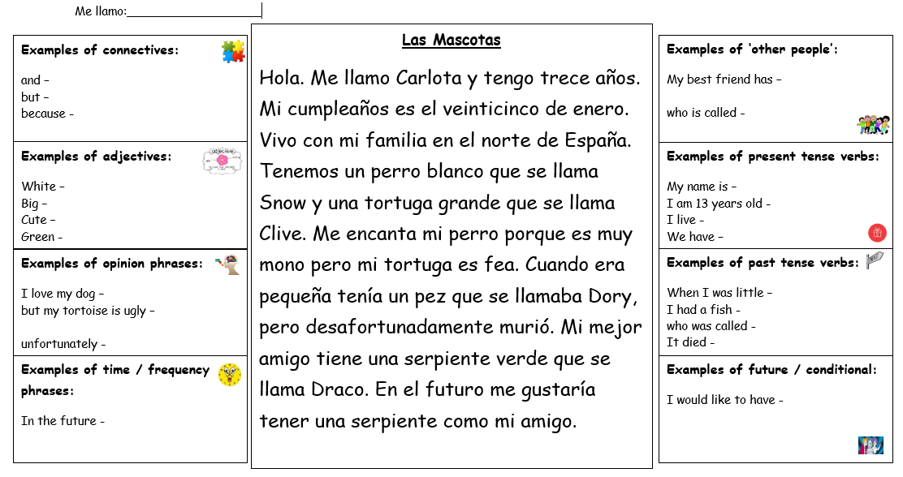
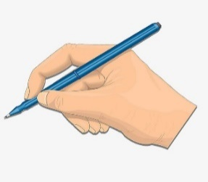
OBJETIVOS:
Bronce:
TBAT give information about what pets I have, and someone else has
Plata:
TBAT say what pets I used to have when I was little
Oro:
TBAT say what pets I would like to have in the future
LITERACY:
Spellings
Extension Challenge: Can you transform the above text into images representing it?

Slide 9
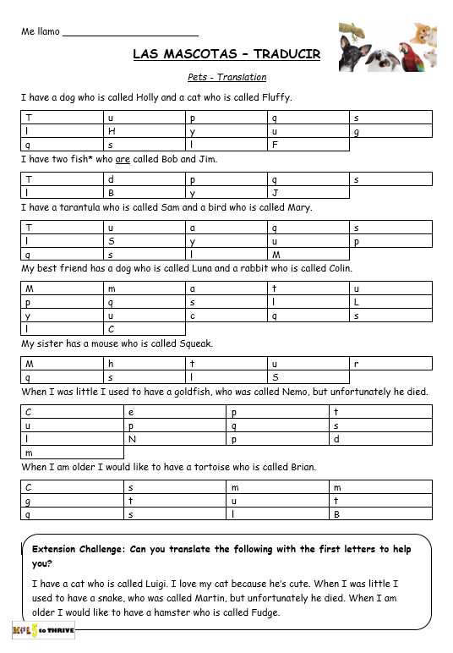
OBJETIVOS:
Bronce:
TBAT give information about what pets I have, and someone else has
Plata:
TBAT say what pets I used to have when I was little
Oro:
TBAT say what pets I would like to have in the future
LITERACY:
Spellings
Vocabulario
un perro – a dog
un gato – a cat
un pez – a fish
dos peces – two fish
un caballo – a horse
un cobayo – a guinea pig
un conejo – a rabbit
una tortuga – a tortoise
un ratón – a mouse
un pájaro – a bird
una serpiente – a snake
una araña – a spider

Slide 10
OBJETIVOS:
Bronce:
TBAT give information about what pets I have, and someone else has
Plata:
TBAT say what pets I used to have when I was little
Oro:
TBAT say what pets I would like to have in the future
LITERACY:
Spellings
Say what pets you have and a friend has
E.G. Tengo un perro que se llama Jim.
Mi amigo tiene un gato que se llama Fred.
Bronze plus:
Say what pets you used to have when you were little.
E.G. Cuando era pequeño tenía un conejo que se llamaba Snowy pero murió.
Bronze & silver plus:
Say what pets you would like to have in the future.
E.G. Me gustaría tener una serpiente verde y un pájaro que se llaman Snape y Harry.

Slide 12
¿Cómo eres?
What do you look like?
OBJETIVOS:
Bronce:
TBAT describe my appearance and someone else’s.
Plata:
TBAT describe my appearance using two tenses.
Oro:
TBAT describe my appearance using a range of tenses.
LITERACY:
Spellings
martes el 29 de enero
¿QUÉ RECUERDAS? What do you remember?
Translate as many as possible into English.
EL MES PASADO LAST MONTH (3 POINTS PER BOX) | LA SEMANA PASADA LAST WEEK (2 POINTS PER BOX) | LA CLASE PASADA LAST LESSON (1 POINT PER BOX)
Cuando hace sol practico la natación con mi padre. | Mi cumpleaños es el quince de abril. | Tengo un perro blanco que se llama Juan. Tiene cuatro años.
Cuando nieva practico el esquí con mis amigos pero es difícil. | El cumpleaños de mi hermano es el veinte de diciembre. Tiene cinco años. | En el futuro me gustaría tener un perro y un pájaro.
Cuando llueve veo la televisión con mi hermana porque es divertido. | El cumpleaños de mi madre es el nueve de octubre. Tiene treinta y dos años. | Cuando era jóven tenía un gato que se llamaba Luisa.
5 minutes

Slide 13
¿Cómo eres?
What do you look like?
OBJETIVOS:
Bronce:
TBAT describe my appearance and someone else’s.
Plata:
TBAT describe my appearance using two tenses.
Oro:
TBAT describe my appearance using a range of tenses.
LITERACY:
Spellings
martes el 29 de enero
¿QUÉ RECUERDAS? What do you remember?
Translate as many as possible into English.
EL MES PASADO LAST MONTH (3 POINTS PER BOX) | LA SEMANA PASADA LAST WEEK (2 POINTS PER BOX) | LA CLASE PASADA LAST LESSON (1 POINT PER BOX)
Cuando hace sol practico la natación con mi padre . | Mi cumpleaños es el quince de abril. Tengo veinte años. | Tengo un perro blanco que se llama Juan. Tiene cuatro años.
Cuando nieva practico el esquí con mis amigos pero es difícil. | El cumpleaños de mi hermano es el veinte de diciembre. Tiene cinco años. | En el futuro me gustaría tener un perro y un pájaro.
Cuando llueve veo la televisión con mi hermana porque es divertido. | El cumpleaños de mi madre es el nueve de octubre. Tiene treinta y dos años. | Cuando era pequeño tenía un gato que se llamaba Luisa.
When it’s sunny I practise swimming with my dad.
My birthday is the 15th of April. I’m 15 years old.
I have a white dog who is called John. He is four years old.
When it snows I practise skiing with my friends, but it’s difficult.
My brother’s birthday is the 20th of December. He is 5 years old.
In the future I would like to have a dog and a bird.
When it rains I watch TV with my sister because it’s fun.
My mum’s birthday is the 9th of October. She is thirty two years old.
When I was little I used to have a cat who was called Luisa.
6 pts – 1 MFL
9 pts – 2 MFL
12+ pts – 3 MFL

Slide 14
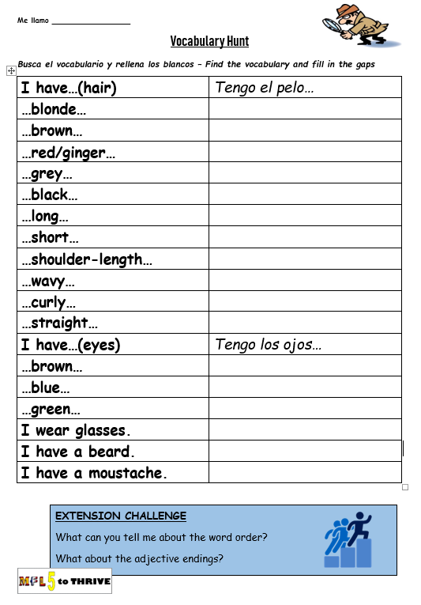
OBJETIVOS:
Bronce:
TBAT describe my appearance and someone else’s.
Plata:
TBAT describe my appearance using two tenses.
Oro:
TBAT describe my appearance using a range of tenses.
LITERACY:
Spellings

Slide 15
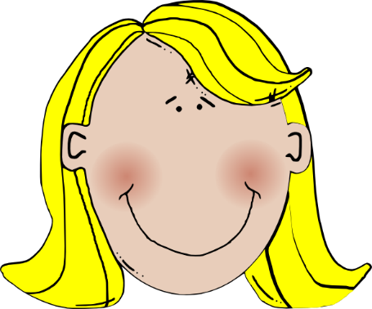
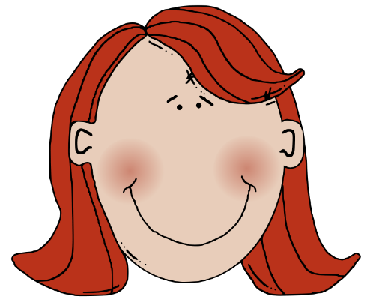
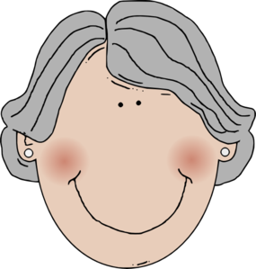
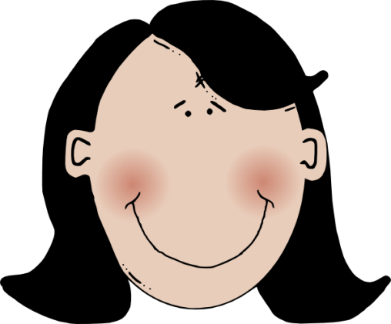
Tengo el pelo…
OBJETIVOS:
Bronce:
TBAT describe my appearance and someone else’s.
Plata:
TBAT describe my appearance using two tenses.
Oro:
TBAT describe my appearance using a range of tenses.
LITERACY:
Spellings
rubio
castaño
pelirrojo
gris
negro

Slide 16
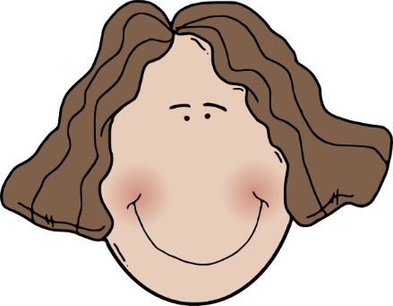
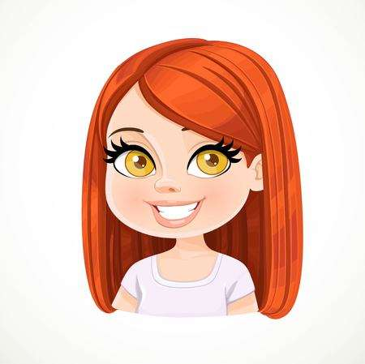
Tengo el pelo…
OBJETIVOS:
Bronce:
TBAT describe my appearance and someone else’s.
Plata:
TBAT describe my appearance using two tenses.
Oro:
TBAT describe my appearance using a range of tenses.
LITERACY:
Spellings
largo
ondulado
corto
rizado
hasta los hombros
liso

Slide 17
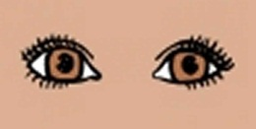
Tengo los ojos…
OBJETIVOS:
Bronce:
TBAT describe my appearance and someone else’s.
Plata:
TBAT describe my appearance using two tenses.
Oro:
TBAT describe my appearance using a range of tenses.
LITERACY:
Spellings
marrones
azules
verdes

Slide 18
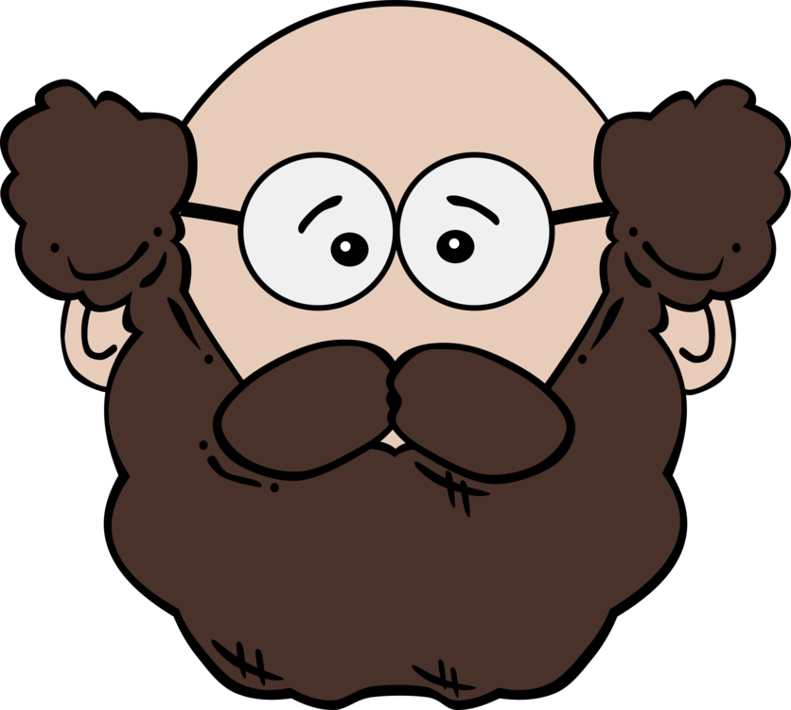
Llevo…
OBJETIVOS:
Bronce:
TBAT describe my appearance and someone else’s.
Plata:
TBAT describe my appearance using two tenses.
Oro:
TBAT describe my appearance using a range of tenses.
LITERACY:
Spellings
gafas
bigote
barba

Slide 19
OBJETIVOS:
Bronce:
TBAT describe my appearance and someone else’s.
Plata:
TBAT describe my appearance using two tenses.
Oro:
TBAT describe my appearance using a range of tenses.
LITERACY:
Spellings
THINK, PAIR, SHARE
I have long, brown, straight hair and blue eyes.
Tengo el pelo largo, castaño y liso y los ojos azules.

Slide 20
OBJETIVOS:
Bronce:
TBAT describe my appearance and someone else’s.
Plata:
TBAT describe my appearance using two tenses.
Oro:
TBAT describe my appearance using a range of tenses.
LITERACY:
Spellings
THINK, PAIR, SHARE
I have short, blonde hair and brown eyes.
Tengo el pelo corto y rubio y los ojos marrones.

Slide 21
OBJETIVOS:
Bronce:
TBAT describe my appearance and someone else’s.
Plata:
TBAT describe my appearance using two tenses.
Oro:
TBAT describe my appearance using a range of tenses.
LITERACY:
Spellings
THINK, PAIR, SHARE
I have long, curly, red hair and green eyes.
Tengo el pelo largo, rizado y pelirrojo y los ojos verdes.

Slide 22
OBJETIVOS:
Bronce:
TBAT describe my appearance and someone else’s.
Plata:
TBAT describe my appearance using two tenses.
Oro:
TBAT describe my appearance using a range of tenses.
LITERACY:
Spellings
Escuchar
 | Hair | Eyes | Extra detail?
1
2
3
4

Slide 23
OBJETIVOS:
Bronce:
TBAT describe my appearance and someone else’s.
Plata:
TBAT describe my appearance using two tenses.
Oro:
TBAT describe my appearance using a range of tenses.
LITERACY:
Spellings
Tengo el pelo rubio y largo y los ojos verdes como mi madre.
2. Tengo el pelo pelirrojo, corto y liso y los ojos azules. Llevo bigote.
3. Tengo el pelo gris y los ojos marrones. Llevo gafas y barba.
4. Tengo el pelo castaño, ondulado y corto. Tengo los ojos azules como mi padre.

Slide 24
OBJETIVOS:
Bronce:
TBAT describe my appearance and someone else’s.
Plata:
TBAT describe my appearance using two tenses.
Oro:
TBAT describe my appearance using a range of tenses.
LITERACY:
Spellings
Escuchar
 | Hair | Eyes | Extra detail?
1 | blonde, long | green | green eyes like her mum
2 | red, short, straight | blue | moustache
3 | grey | brown | glasses and beard
4 | brown, wavy, short | blue eyes | blue eyes like her dad

Slide 25
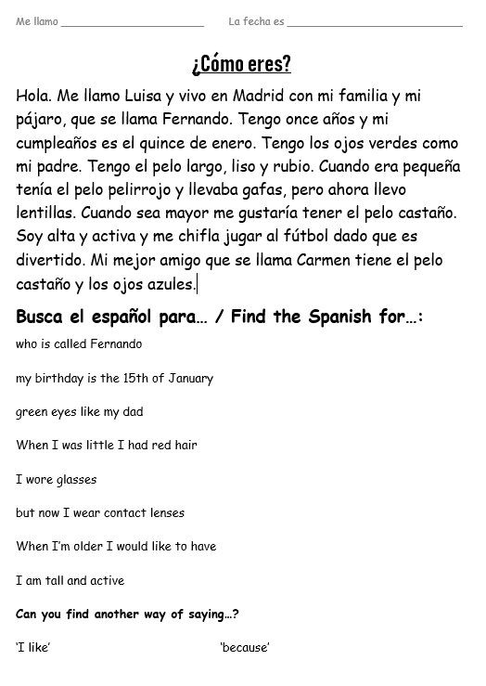
OBJETIVOS:
Bronce:
TBAT describe my appearance and someone else’s.
Plata:
TBAT describe my appearance using two tenses.
Oro:
TBAT describe my appearance using a range of tenses.
LITERACY:
Spellings
Leer
EXTENSION CHALLENGE: Transform the text into a picture

Slide 26
OBJETIVOS:
Bronce:
TBAT describe my appearance and someone else’s.
Plata:
TBAT describe my appearance using two tenses.
Oro:
TBAT describe my appearance using a range of tenses.
LITERACY:
Spellings
Describe your appearance and another member of your family / a friend using the vocabulary you have learnt today. E.G. Tengo el pelo rubio, corto y rizado y los ojos verdes. Mi mejor amigo tiene el pelo castaño y largo y los ojos azules.
Bronze plus:
Describe how you used to look when you were little (it doesn’t have to be true).
E.G. Cuando era pequeño tenía el pelo pellirojo y largo.
Bronze & silver plus:
Say what you would like to look like e.g. what colour hair/eyes you would like to have.
E.G. Me gustaría tener el pelo rubio y liso y los ojos azules.

